Slide 1

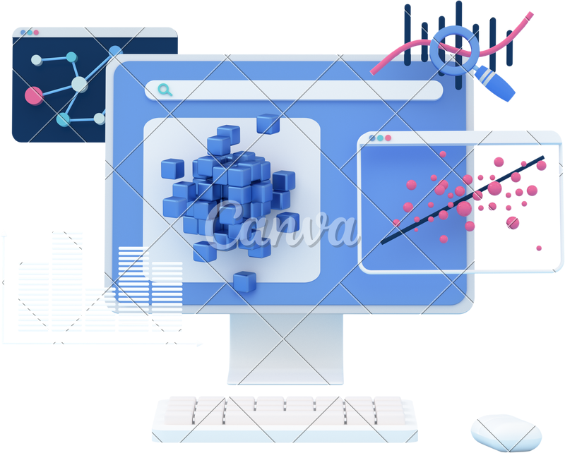


Insider Trading
Data and AI in Economics
Fatima-zahra Jabir Joško Kristić Keunwoo Kim

Slide 2



Topics of presentation
Definition of Insider Trading Regulations of Insider Trading Data Sources
Look into the Dataset Scoring insider Trades Copy-Trading Strategies
Analysis of chosen strategy
Conclusion

Slide 3
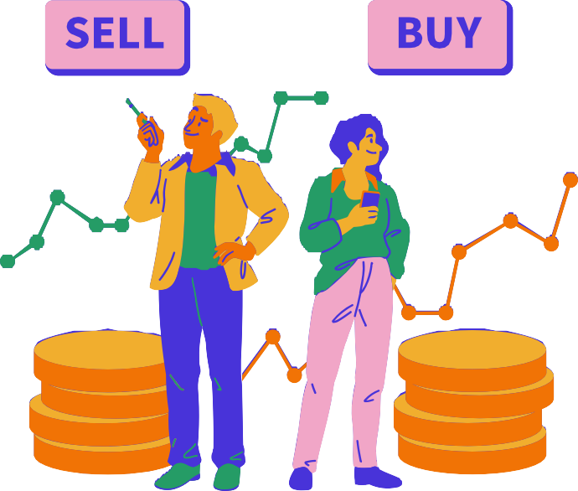



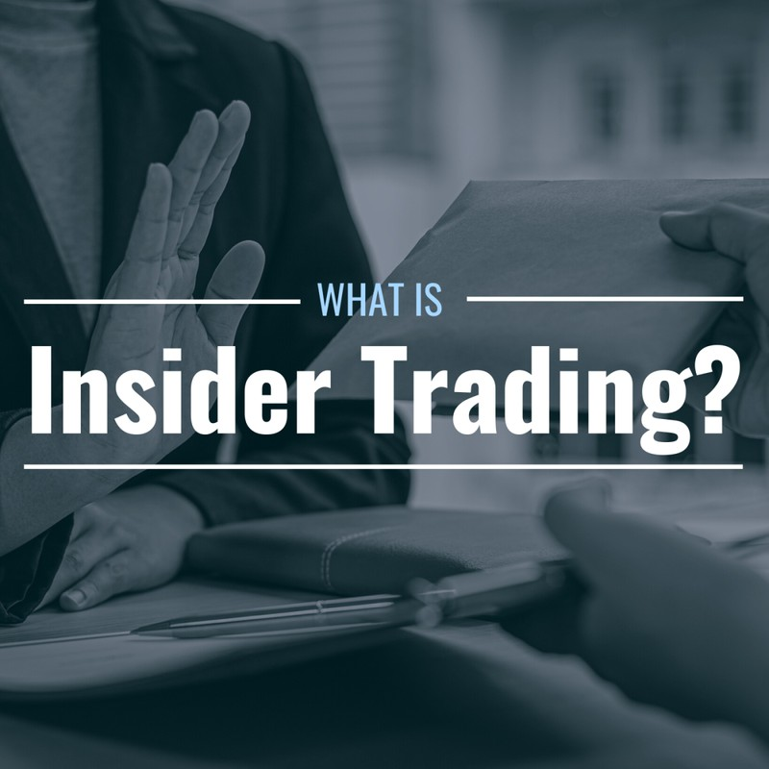

Insider Trading
Insider trading involves buying or selling securities using non-public, privileged information obtained through a position within the company or a privileged relationship
Difference between Legal and illegal Insider Trading
Legal Insider Trading: Transactions by company insiders (executives, board members, major shareholders) publicly disclosed as per regulations.
Illegal Insider Trading: Buying or selling securities based on non-public, material information, including tipping others who trade on it.
insiders
that are

Slide 4




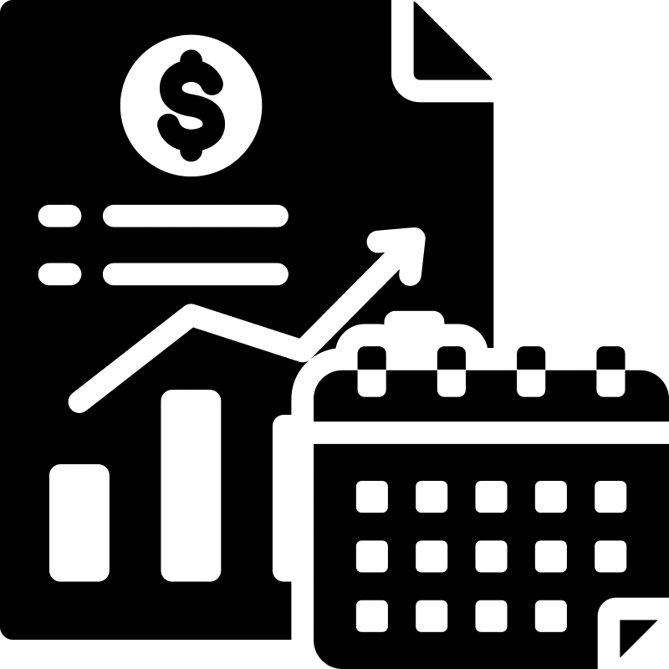

Reporting Process
Initial Declaration
Transaction Reporting
Reporting each specific transaction, submitted within two business days of the transaction.
Periodic Reports
Certain transaction may require additional periodic reports.
When a person is an insider, they must declare their initial holdings.
SEC: The Securities and Exchange Commission - SEC Official Website

Slide 5




Regulatory Body
Insider trading is regulated by the Securities and Exchange Commission (SEC), which ensures the fairness and transparency of financial markets and takes action against illegal insider trading
Regulatory Bodies
and Insider Trading Laws
Laws and Regulations
he main laws include the Securities Exchange Act of 1934, which established the SEC, and rules such as Rule 10b-5, which prohibits fraud and manipulation in securities transactions.
Securities Exchange Act of 1934: Full Text Rule 10b-5: SEC Rule 10b-5

Slide 6





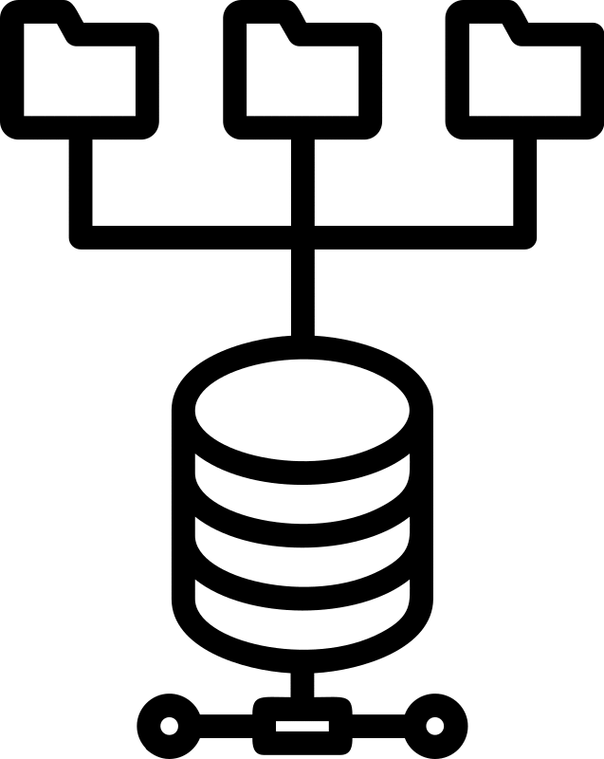

Data sources
Insider trading API by sec-api.io
To get reported insider trades
Mapping API by sec- api.io
To get information about sector and industry for specific stock
Yahoo finance
To get historical stock prices

Slide 7



Transforming data from SEC filings data into appropriate Pandas dataframe format
Adjusting share prices in SEC filings for stock splits using historical stock info
Keeping only non- derivative trades after 01.01.2019.
Preprocessing

Slide 8




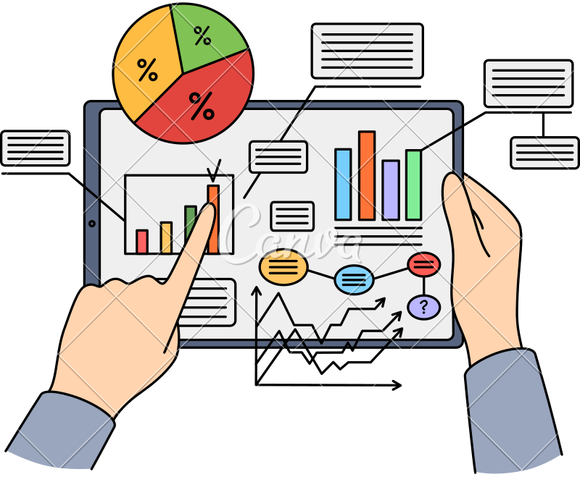
Exploratory data analysis

Slide 9

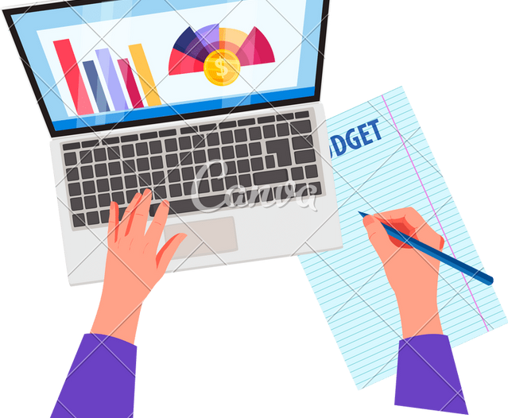
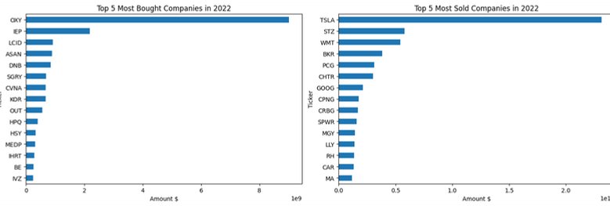

Top 5 stocks that most buy/sell for each years
OXY - BERKSHIRE HATHAWAY INC is the insider trader who bought 99% of insider trading in 2022 of OXY
TSLA - From April through December in 2022, Musk sold $22.9 billion worth of Tesla stock in unscheduled sales to help fund his $44 billion purchase of Twitter that year

Slide 10
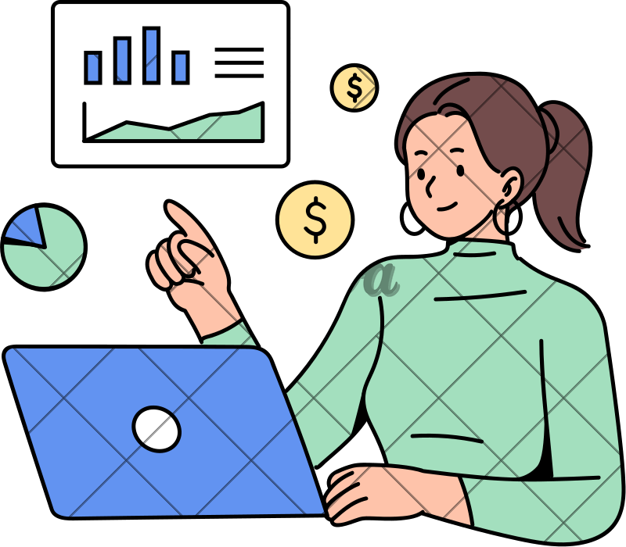
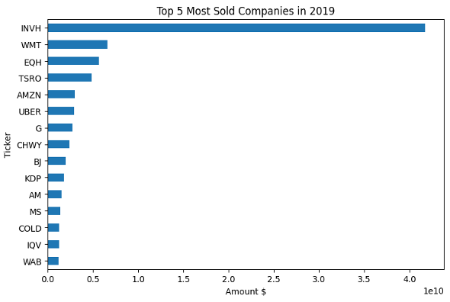
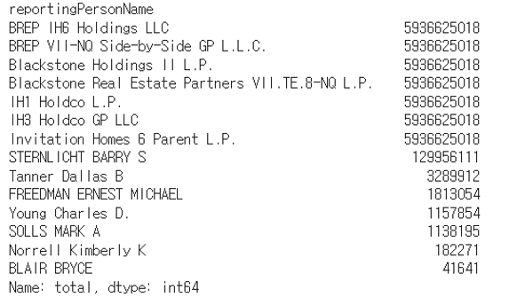

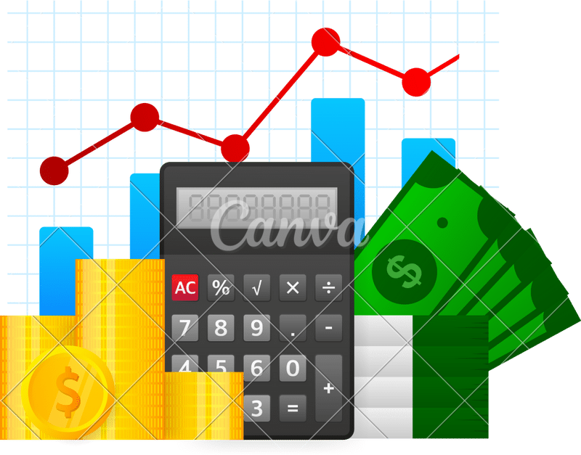

Top 5 stocks that most buy/sell for each years
INVH- We can see some insider trades look exactly same. Possible outlier.

Slide 11
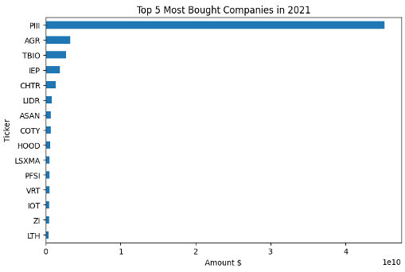
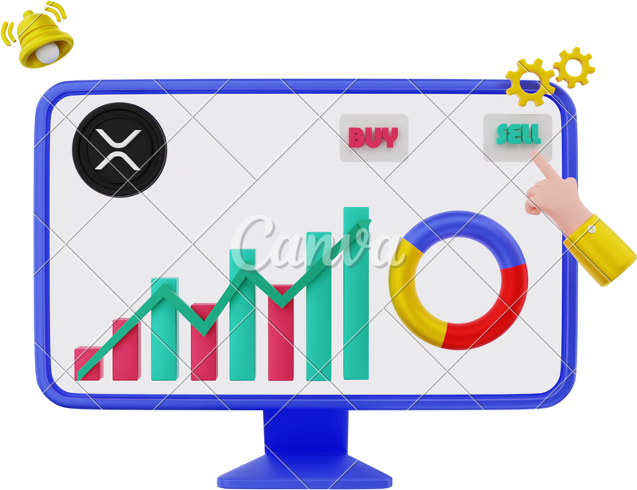
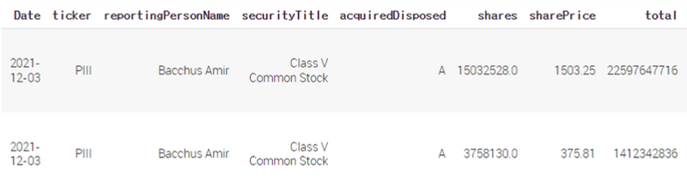

Top 5 stocks that most buy/sell for each years
PIII- There was stock merge on 03 DEC 2021. This can be the reason that the data looks outlier.

Slide 12

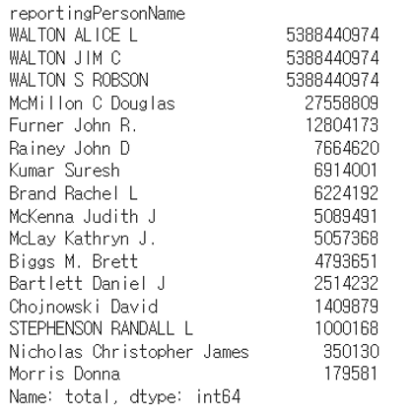
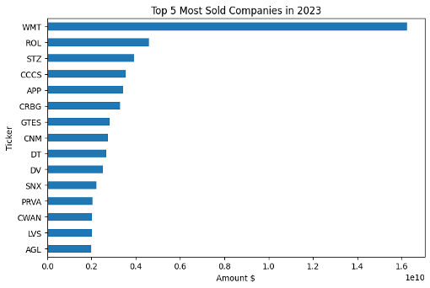


Top 5 stocks that most buy/sell for each years
WMT- Those Insider trading of three Walton looks same. Possible Outliers.
Insider traded of WMT in 2023

Slide 13


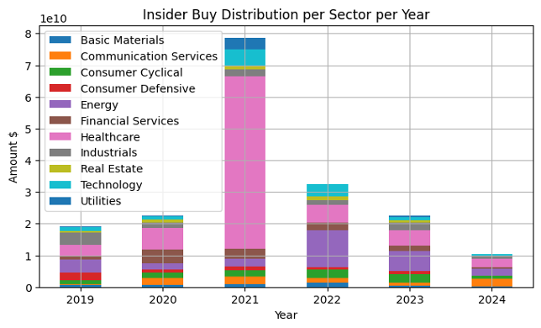
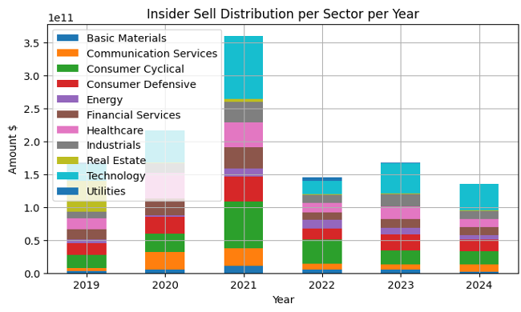
Portion of each sector for each years
In 2021, huge amount in Health care. This amount is because of ‘PIII’, the possible outlier.
From 2019 to 2021 the insider buy or sell both increased. But, nowadays, insider trading volume is smaller than those period.

Slide 14
- Volume of insider buys&sells together with S&P500 movement through time
●There is long green line around 2022, which is because of ‘PIII’
●Disposed volume was a lot in COVID-19 era.

Slide 15

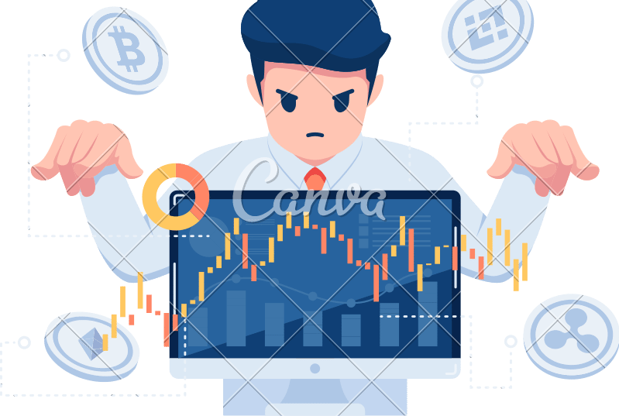
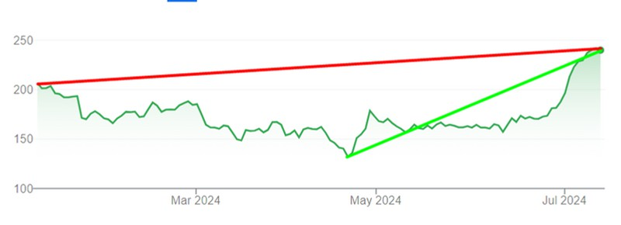
Defining good trades
We want to conclude whether insider trade was good or bad, not how the stock performed
Return of every insider trade will be highly correlated with stock performance

Slide 16



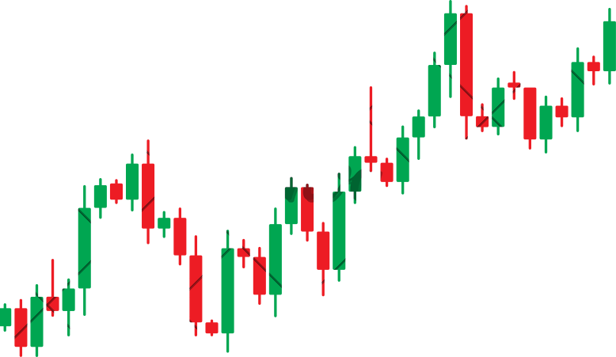


Scoring trades
Return between the average future price and price at the moment of insider trade
Focusing on specific point in future after the trade like 1 week, 1 month, 3m and 6m
Standardizing this return with yearly performance of that stock and volatility

Slide 17

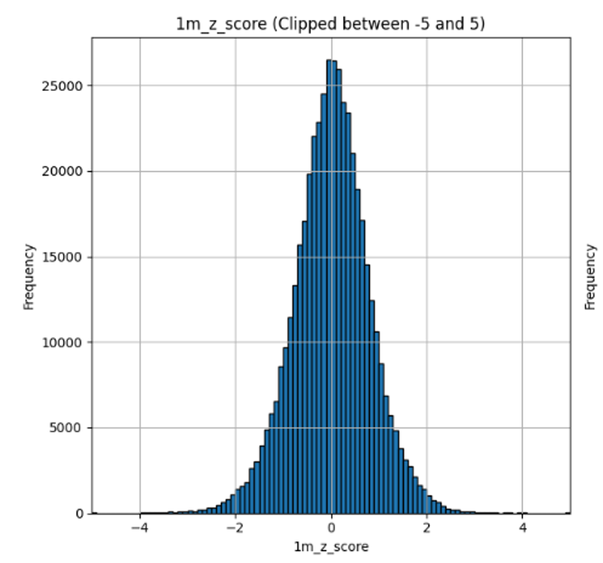

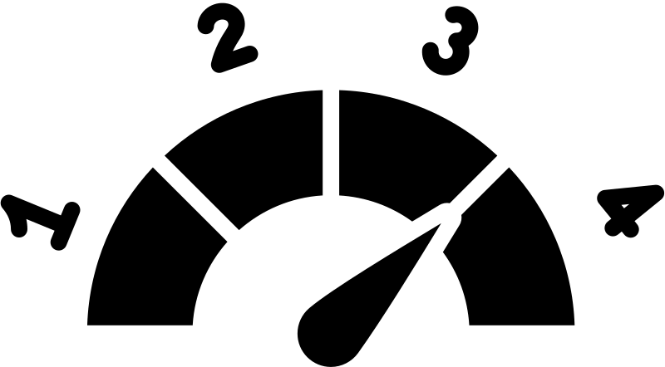
Distribution of scores
Expecting normality to get probabilistic meaning
All 4 time periods show
Satisfying distributions

Slide 18

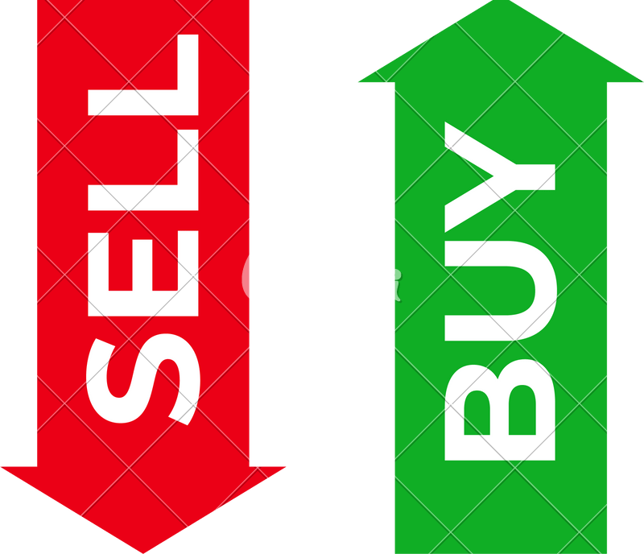
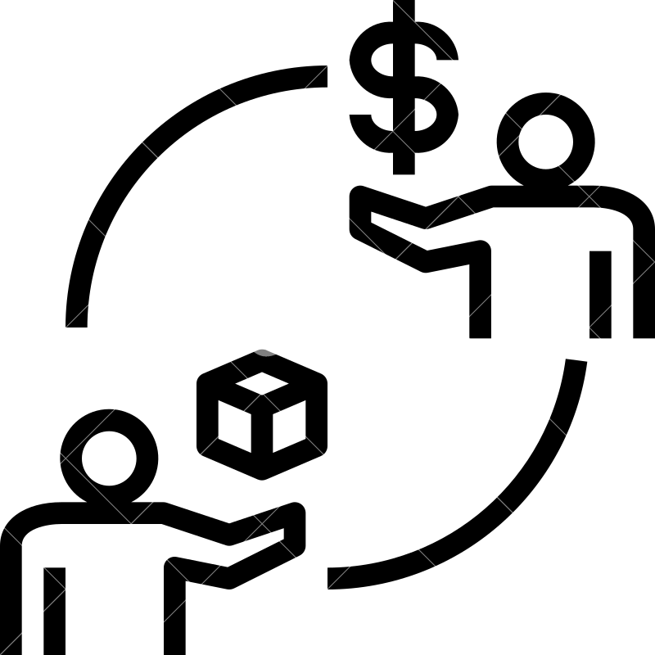
Mean z-scores
1 week
0.101441
0.012185
1 month
0.073218
-0.012612
3 months
0.020717
-0.068996
6 months
-0.103653
-0.092063
Buys
Sells
Buys outperform sells
Probably biased by constantly increasing market

Slide 19




Identifying top performers by average z- score on 1 month period from 01.01.2019. - 01.01.2023
01
2
Copy-trading them during year 2023.
Simple copy-trading strategy
Keeping it simple and assuming every trade is done with same amount of capital and closed exactly 1 month later.
3
4
Ran on both buys and sells.
05
We also tried identifying only top buyers and top sellers but this worked out better.

Slide 20

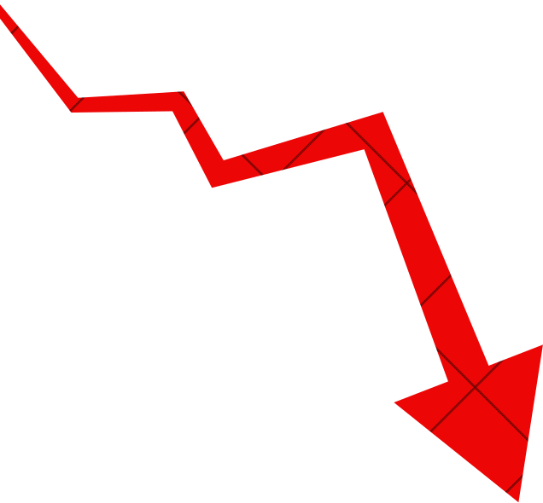
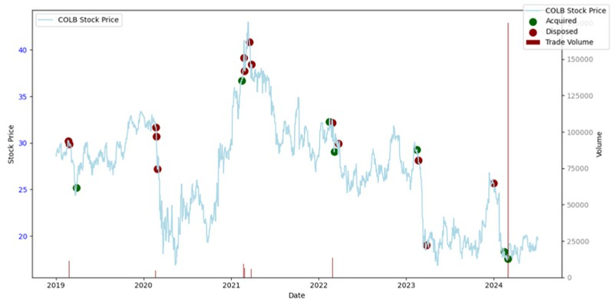
Example of one of the top performers

Slide 21

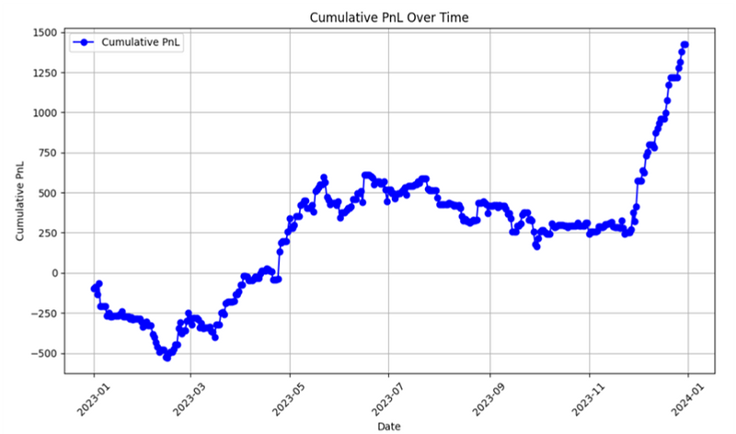
Performance of strategy

Slide 22




Analysis of
chosen strategy

Slide 23



Chosen Strategy
Got ‘Top 100’ insiders, calculated by mean_z score,during train period.
Simply followed them during test period with $100 per trade.
Calculated P&L and statistics of test period.
Train Period: 2019.01 ~ 2022.12 Test Period: 2023.01~2023.12

Slide 24

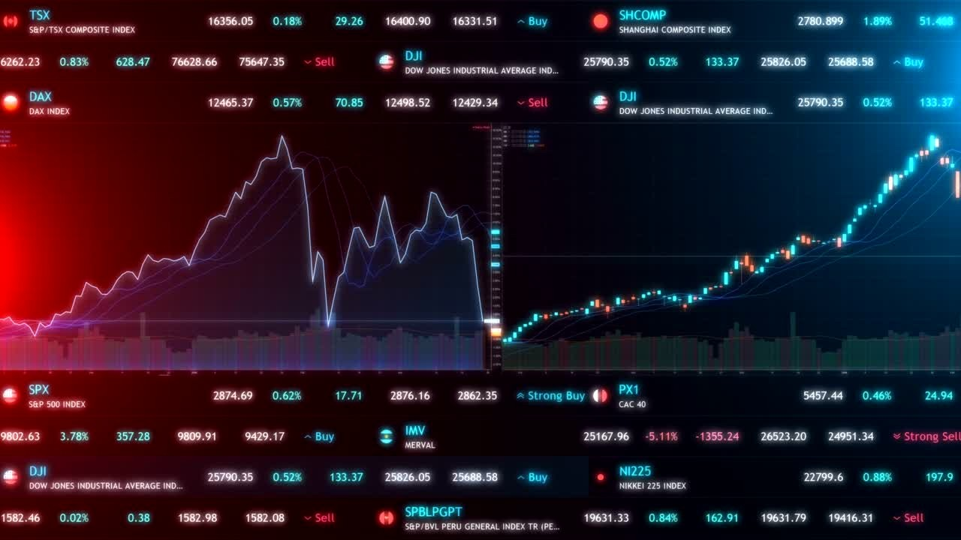

Number of Trades
Train Period: 2019.01 ~ 2022.12 Test Period: 2023.01~2023.12
total insider trades happened: 91,575 trades
total trades followed by our strategy: 911
Total trades: 911
-buy trades: 528
-sell trades: 383

Slide 25


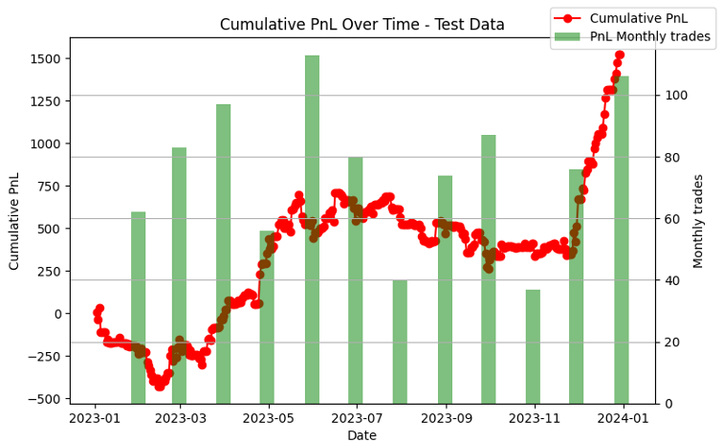
Cumulative PnL
Avg annualized ROI per trade: 22.05%
Avg number of trades per month: 75.92
Best performer: Buller Benyamin with PnL:462.68 Worst performer: AULT MILTON C III with PnL: -588.27

Slide 26

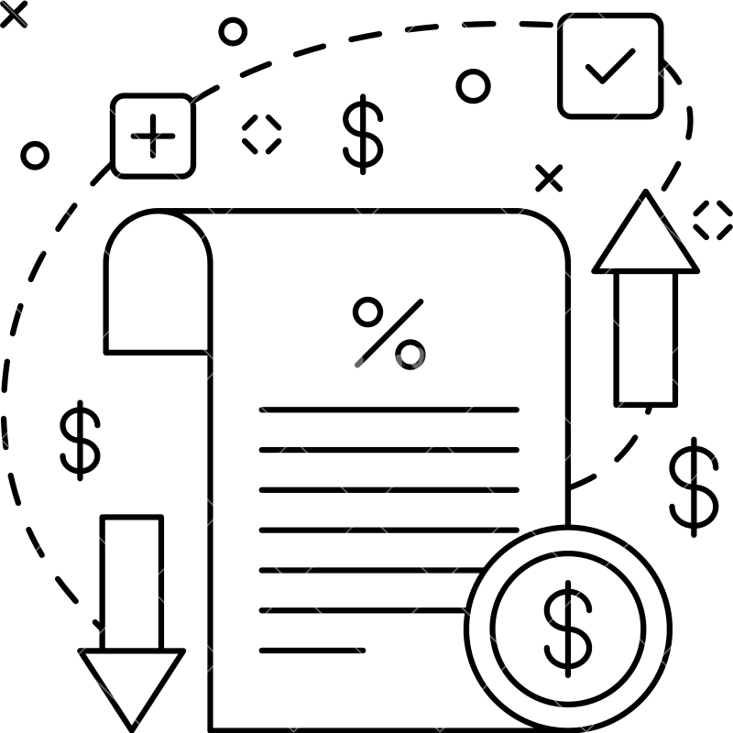
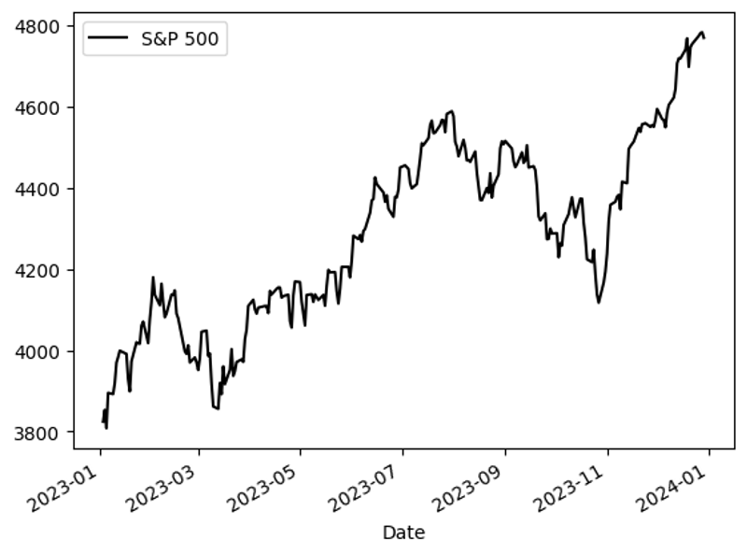

Cumulative PnL
Initial investment: 10000
Size per trade: 100
Alpha: 0.00057
Beta: 0.02556
Mean daily return: 0.06%
Mean return per trade:1.67%
Sharpe ratio: 0.08
Sortino ratio: 0.12
Maximum drawdown: -5%
Per trade volatility: 20.43% Volatility: 0.0042%
Benchmark - S&P 500

Slide 27










Conclusion
sec-api provides rich and substantial datasets that give opportunities to investigate potential illegal insider trading and create trading strategies
Maximum drawdown of 5% of the initial investment through the year shows desirable level of risk management
Strategy did not show significant edge over benchmark, but achieved almost 0 Beta value which bring market neutrality and opportunities to hedge against systematic risk
Future works could include advanced machine learning algorithms used to detect unusually good trades.

Slide 28



Thank you!
Do you have any questions for us?"

